Slide 1
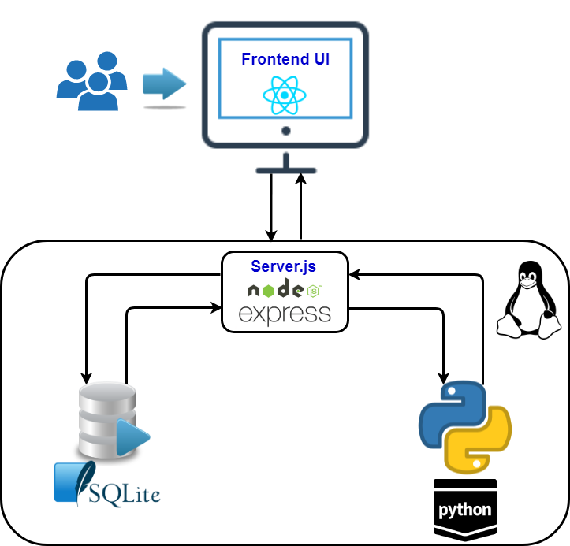
React Test App
Functionalities covered:
CRUD operation :
Creating New record.
Reading All records.
Updated & Delete the selected record.
CSV Operation :
Upload the CSV from desktop and store in Backend file system.
Import the CSV file from the desktop and insert in SQLITE3 database.
Python Script:
Write the Submitted request details into CSV file in file system
D3 Chart:
A simple Bar chart which is created based by Reading All SQLite3 DB
- Srikanth Ramappa

